Slide 1









T-Rex Game
Under the supervision of:
Dr. Ibtsam Omar

Slide 2



Our team
Farida Waheed Abd El Bary | 221903168
Raneem Ahmed Refaat | 221903114
Razan Ahmed Fawzy | 221903165
Mohamed Ahmed Mohamed Hassan | 221903120

Slide 3
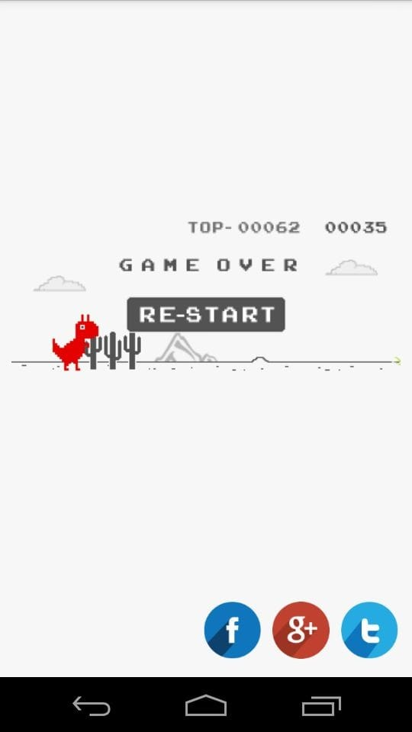




Introduction
We adds a fresh perspective to the T-Rex game. An LDR sensor and a servo motor are combined to provide the virtual experience a more realistic element. We examine the setup, operation, and fascinating results of fusing digital gaming with real-world engagement.

Slide 4







LDR
An essential part of this project is the LDR (Light Dependent Resistor), which reacts actively to changes in the surrounding light. The LDR recognizes these variations in the brightness of light and converts them into electrical impulses. This signal affects the servo motor's movement by acting as a trigger mechanism. By enabling actual light changes to affect the virtual action, the LDR essentially gives the T-Rex game a dynamic element that makes it more engaging and exciting.

Slide 5




Servo Motor
In response to an input from the LDR sensor, the servo motor operates as a dynamic component. The servo motor receives a signal from the LDR sensor when it senses changes in light levels. The servo motor reacts by moving, replicating the jump of the T-Rex dinosaur in the game. By coordinating the imaginary activities on screen with the actual movement of the servo motor, this real-time physical contact improves the gaming experience and makes the games more immersive and interesting.

Slide 6



The Code

Slide 7




Slide 8


Slide 9
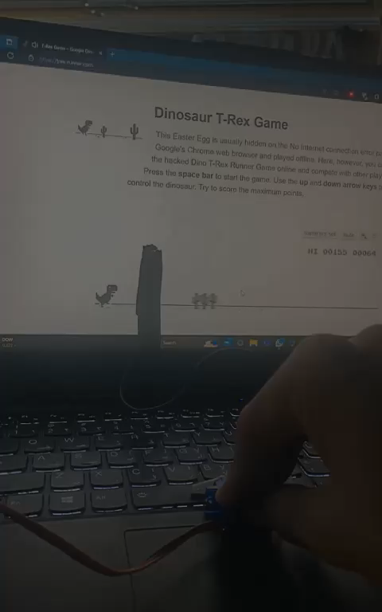

Slide 10
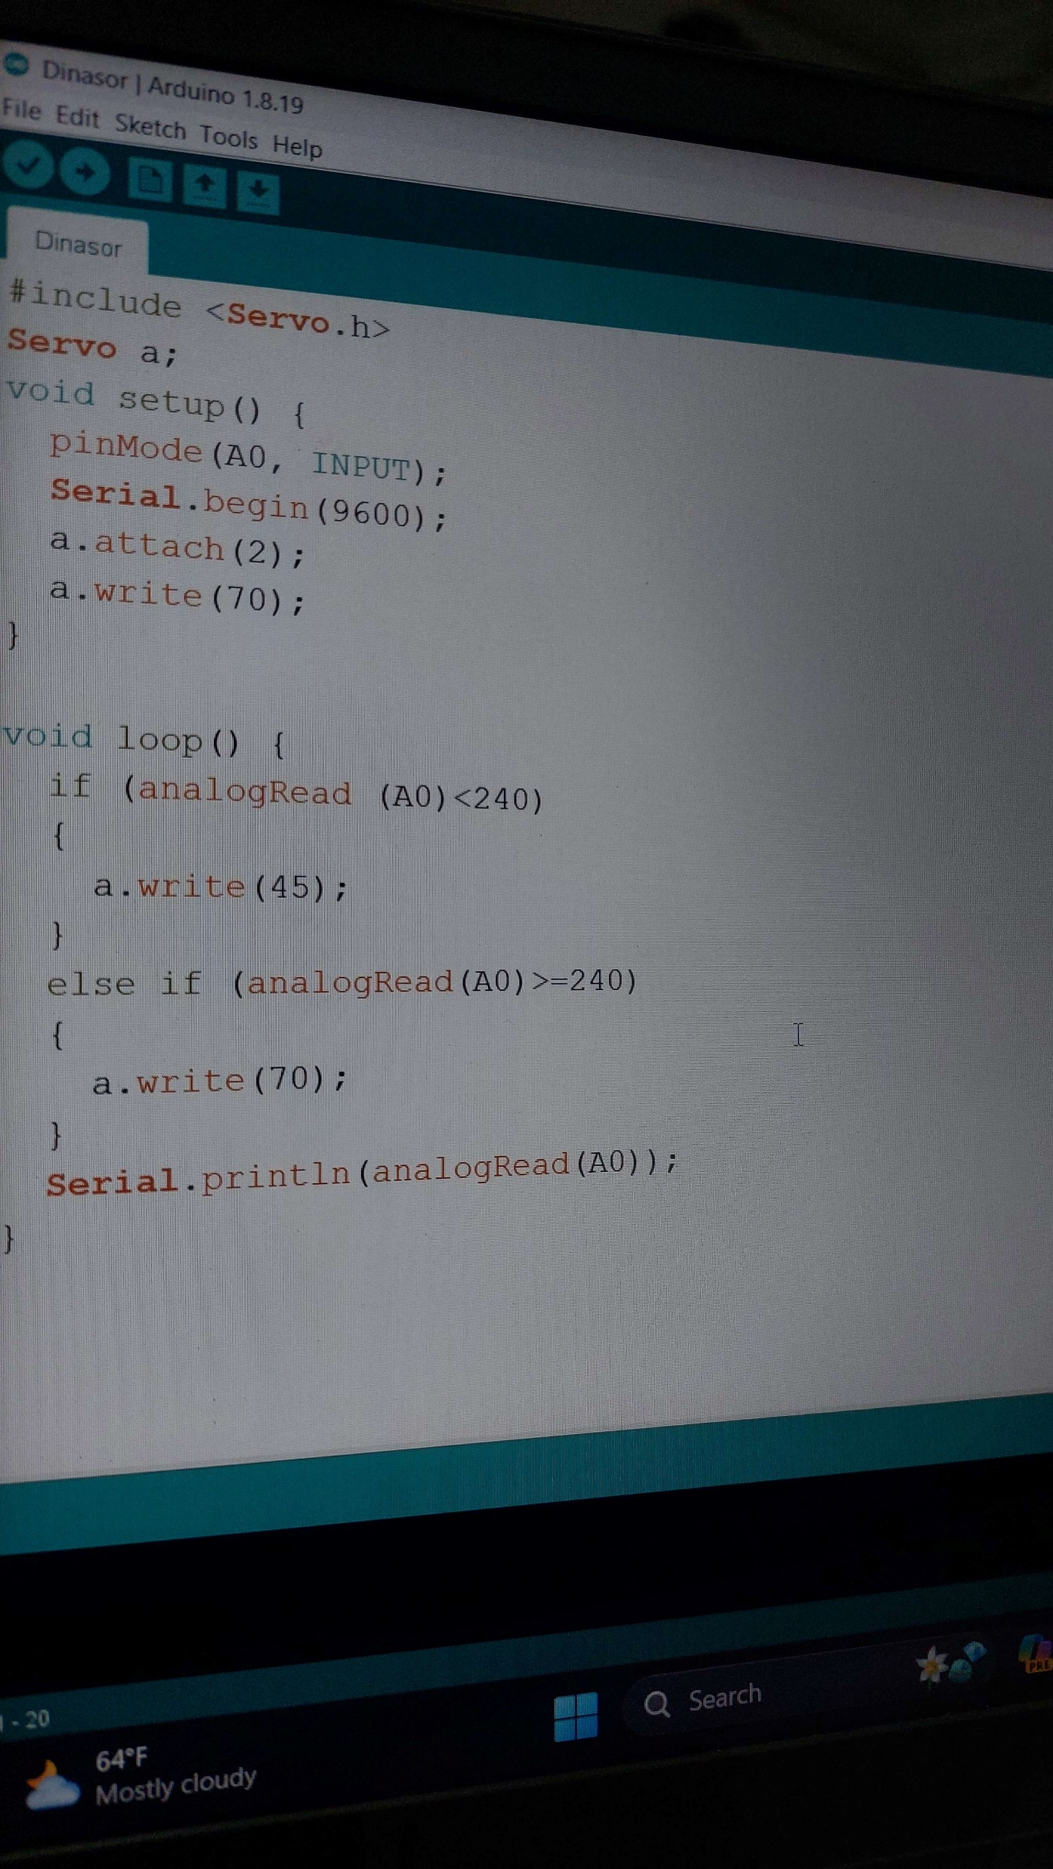

Lastly…
We all went through the frustration of losing the game, but now by implementing our circuit we can easily reach the maximum possible score of 99,999.
This just prove that engineers make the world easier 😉

Slide 11


THANK YOU

